Slide 1
Unit 5 – 1844-1860
Fabric of a Nation (Modules 4-5, 5-1→5-3)
Manifest Destiny and Sectionalism
Manifest Destiny

Slide 2
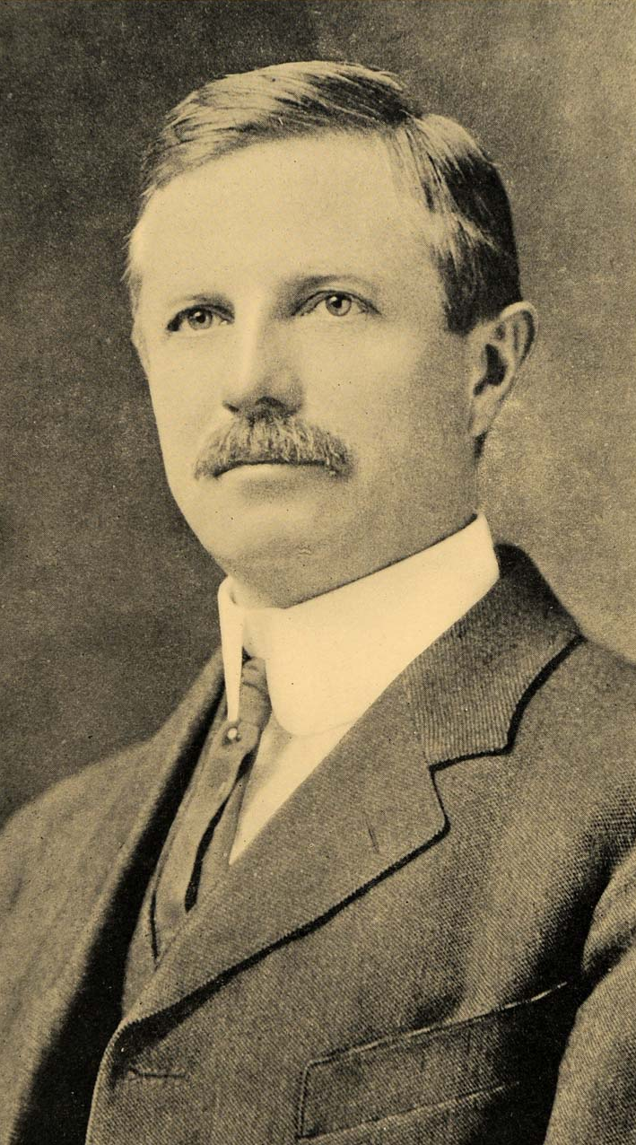
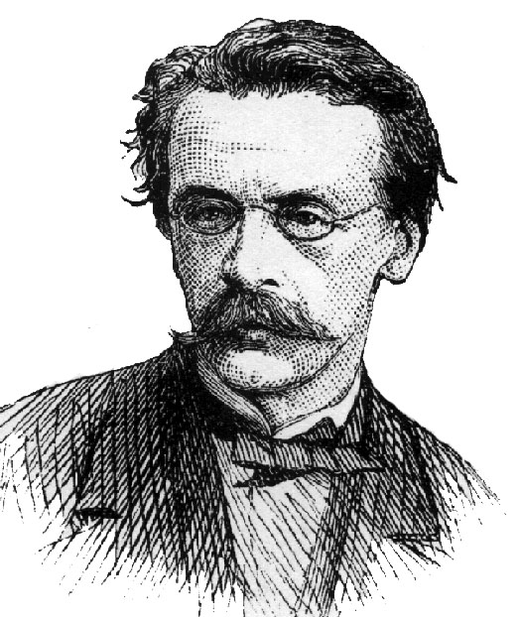
Turner Thesis- 1893
Frederick Jackson Turner
The repeated experience of settling new frontiers across the continent (East to West) shaped Americans into uniquely adventurous, optimistic, rugged, and democratic people
The American identity was forged in the frontier…
John O’Sullivan
New York Journalist
Coined the term “Manifest Destiny”
“(It is)...our manifest destiny to spread and to possess the whole of the continent which Providence has given us for the great development of the great experiment of liberty” (1845)

Slide 3
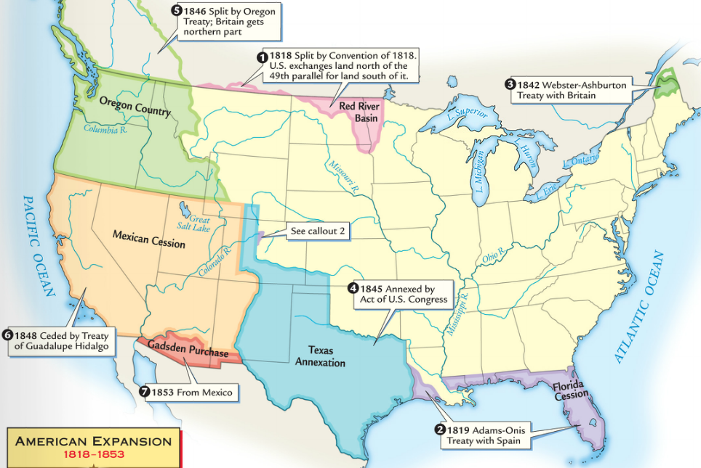
In the 1840s, westward expansion led Americans to acquire all lands from the Atlantic to Pacific in a movement called Manifest Destiny
“Obvious”
“Future”
Americans flooded into the West for new economic opportunities
The U.S. gained Texas, Oregon, California, and other territories through treaty or war

Slide 4
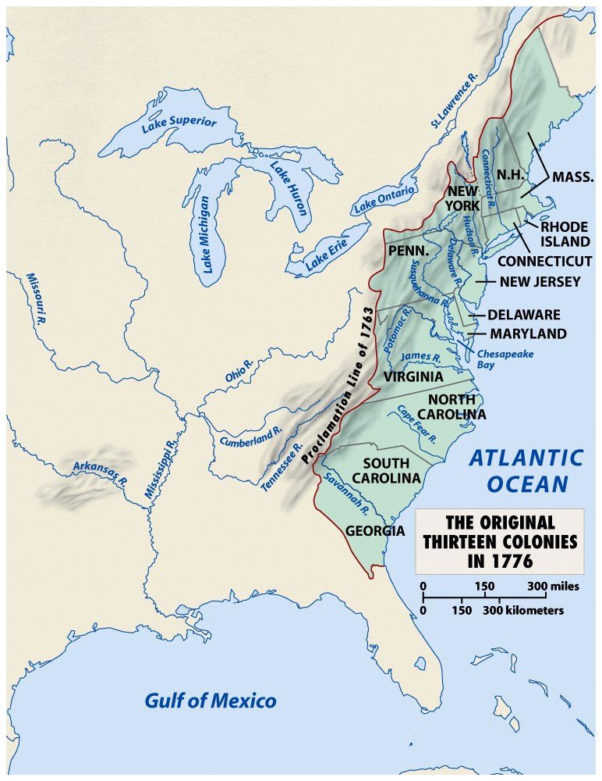
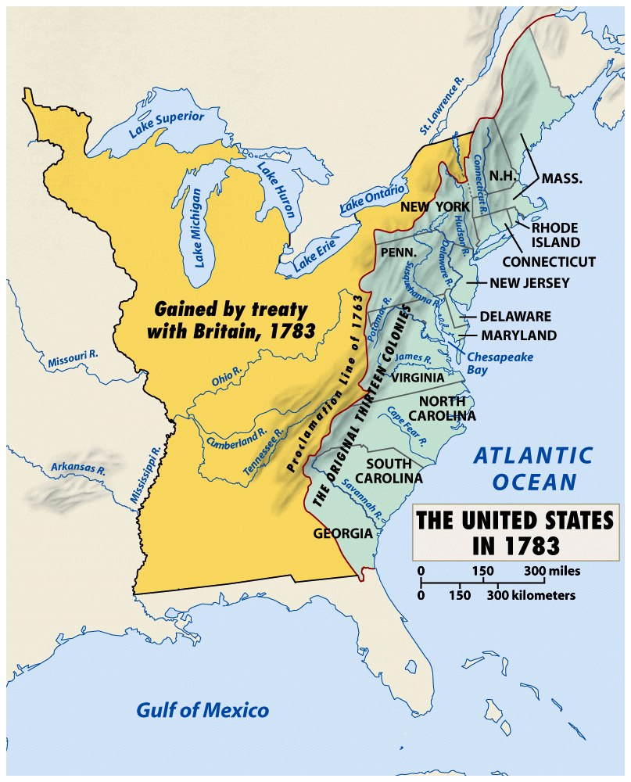
When Americans were colonists (1607-1783), the western border was the Appalachian Mountains
After the Revolutionary War, the western border of the U.S. was the Mississippi River

Slide 5
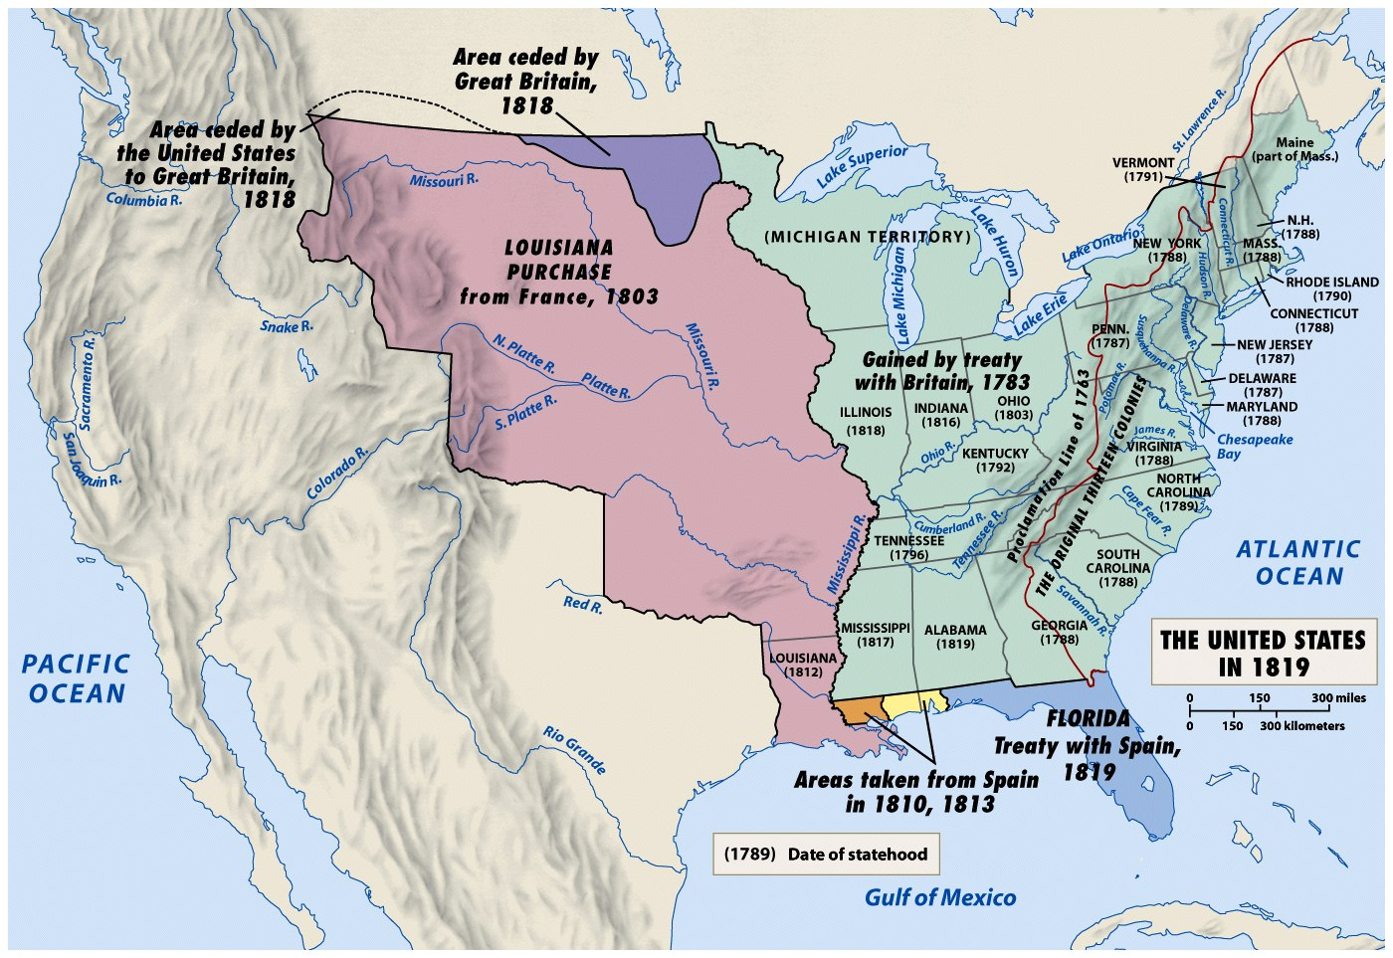
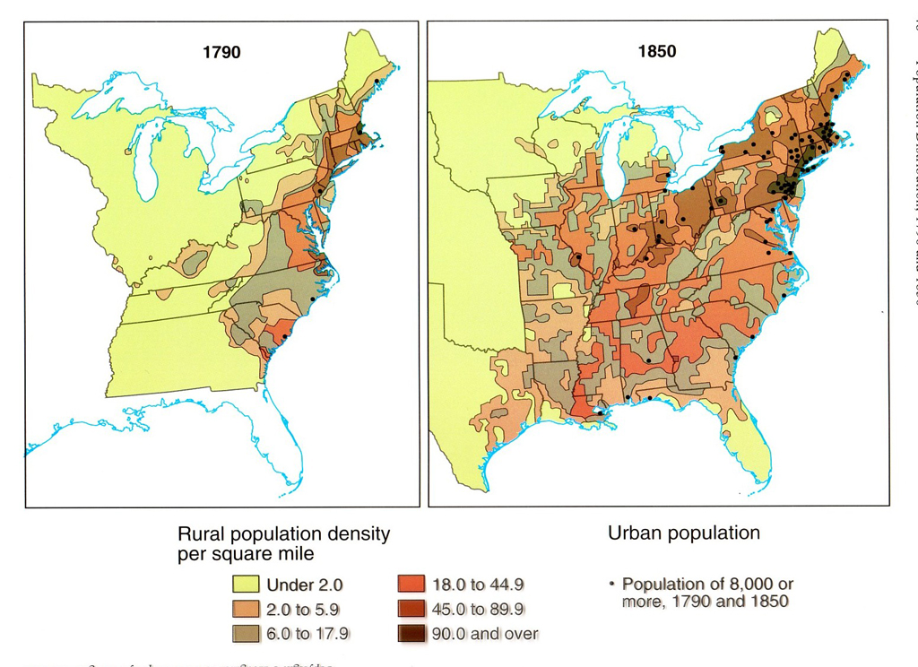
Jefferson’s Louisiana Purchase doubled the size of the U.S.
The growth of “King Cotton” and commercial farming led to a desire for more western lands

Slide 6
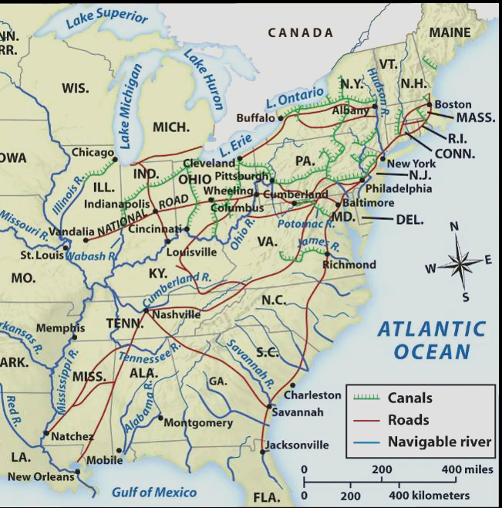
Changes in the early Antebellum era (1800-1840), encouraged westward expansion in the 1840s
Improved transportation such as canals, steamboats, and railroads increased speed and profitability

Slide 7
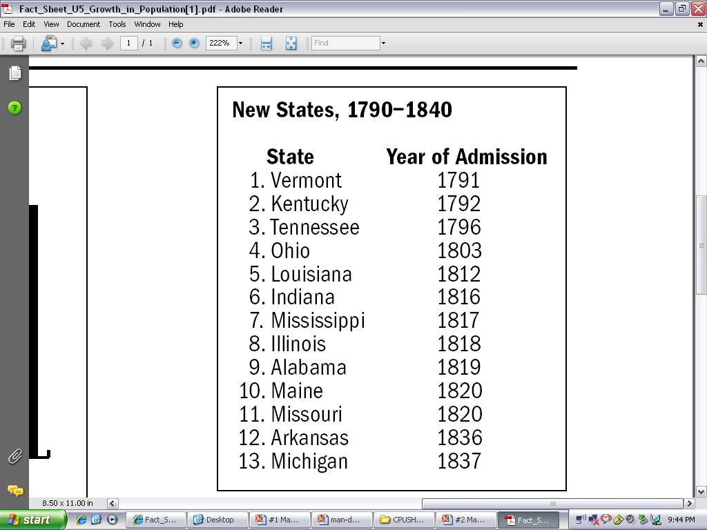
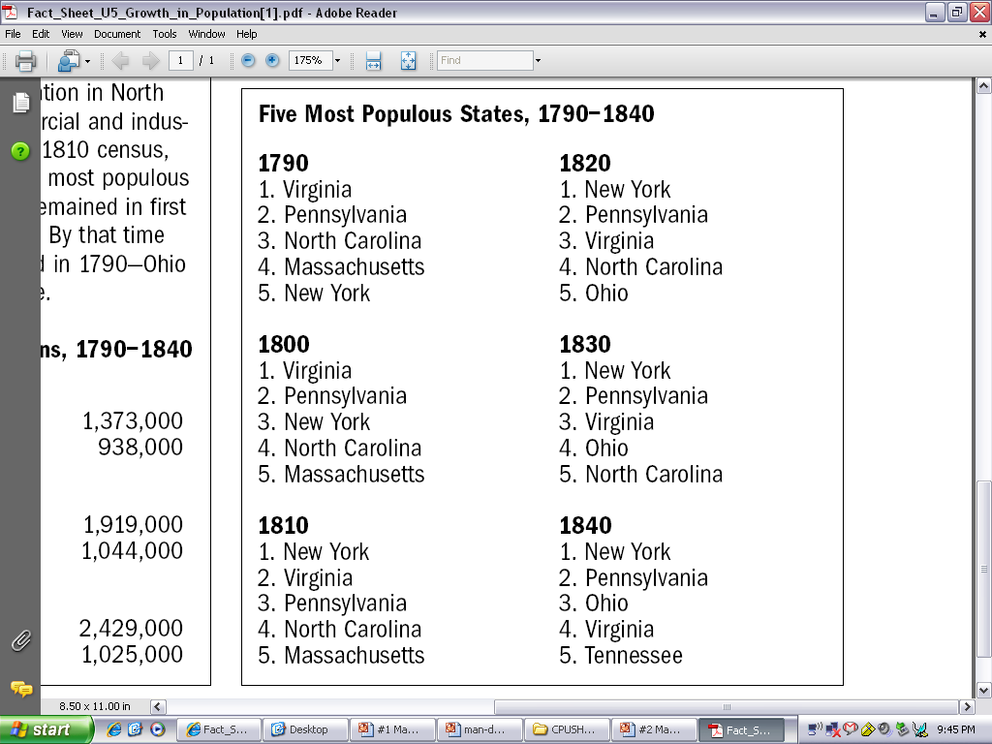
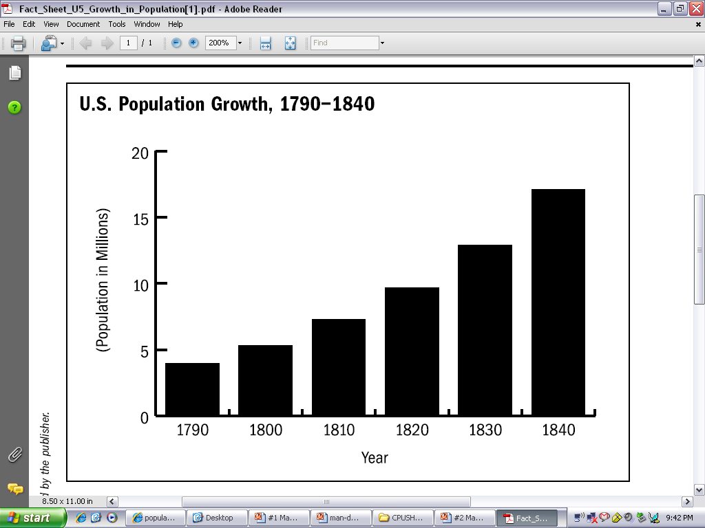
The U.S. population grew 300% (1790-1840)
The number of states grew from 13 to 26
Western state populations exploded (Ohio’s population grew from 50,000 to 1.5 million)

Slide 8
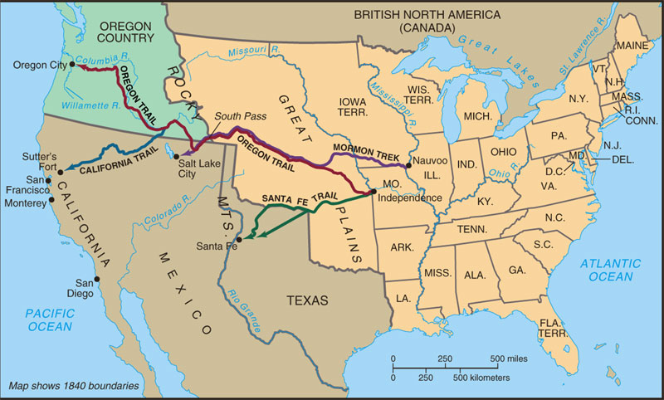
The journey West was dangerous and unpredictable, yet thousands of Americans traveled along the Oregon, Santa Fe, California, and Mormon Trails

Slide 9
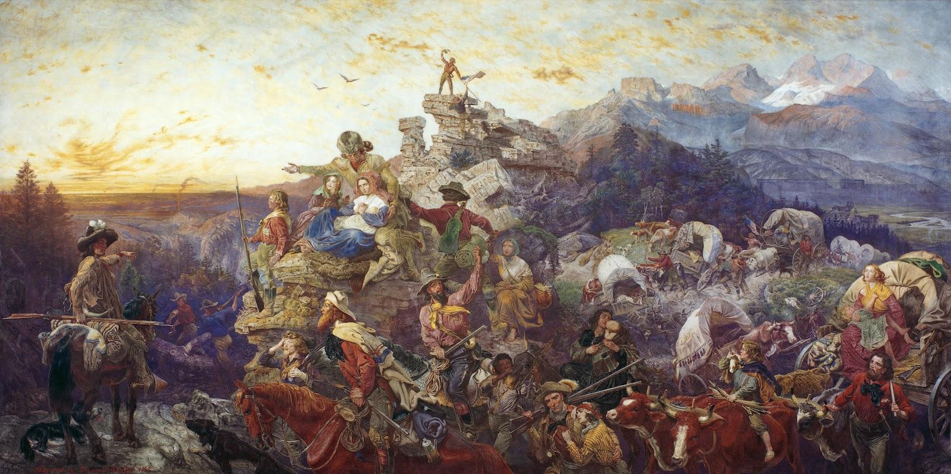
The earliest pioneers were fur traders, land speculators, and poor farmers looking for cheap land
Soon, farmers, miners, ranchers, and religious groups (mostly middle class) flooded Westward.

Slide 10
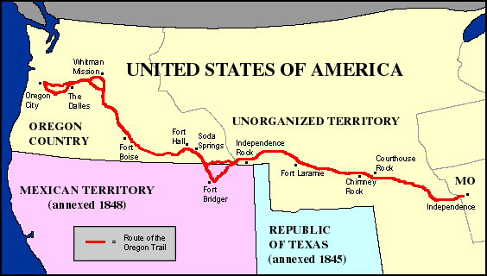
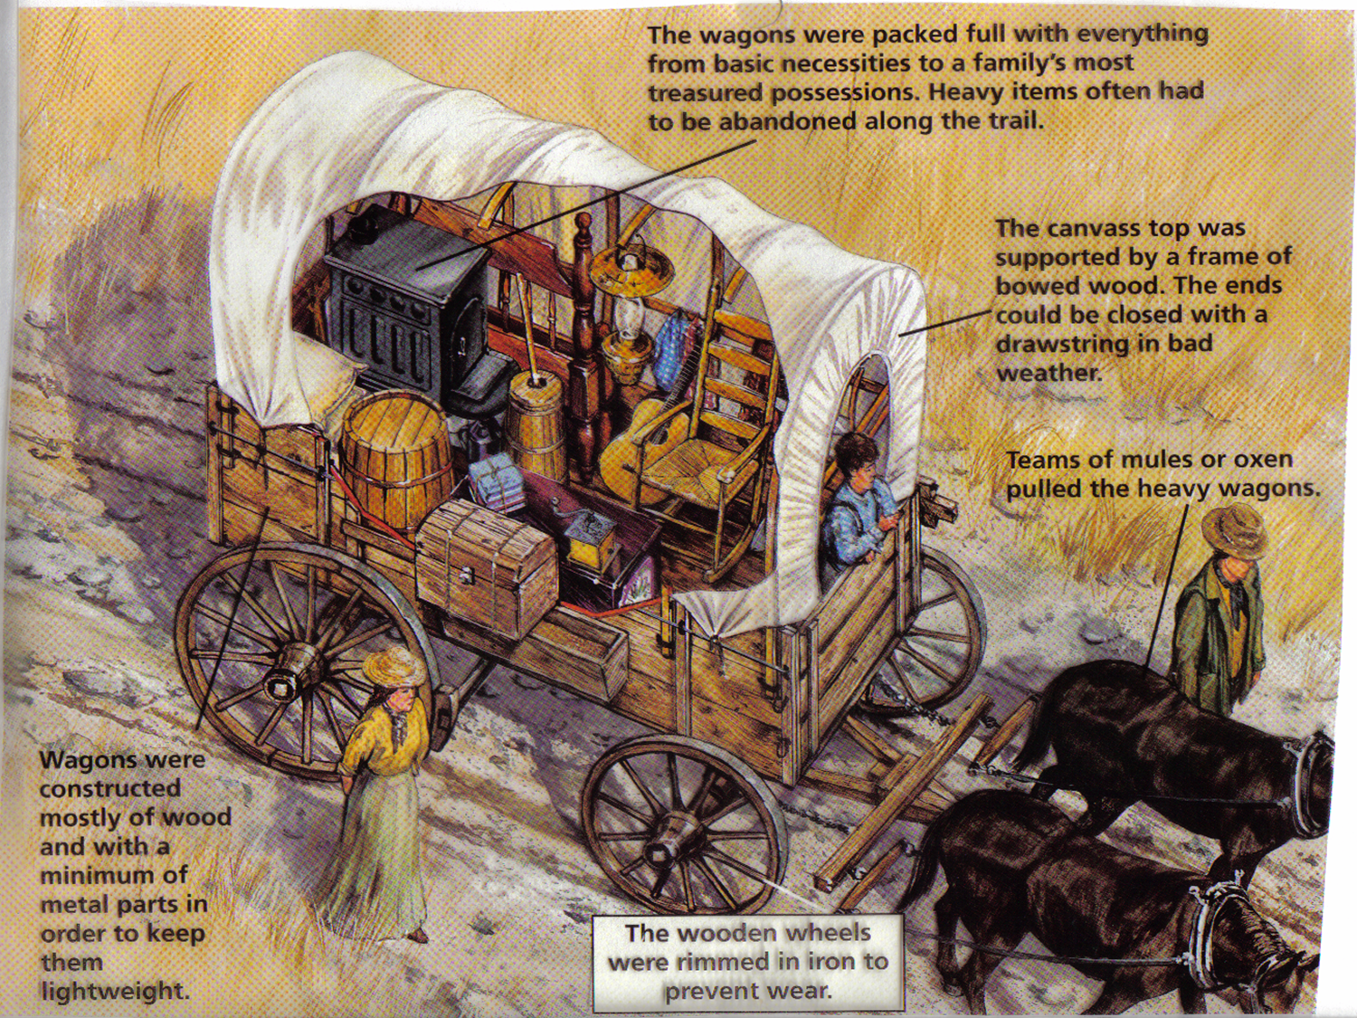
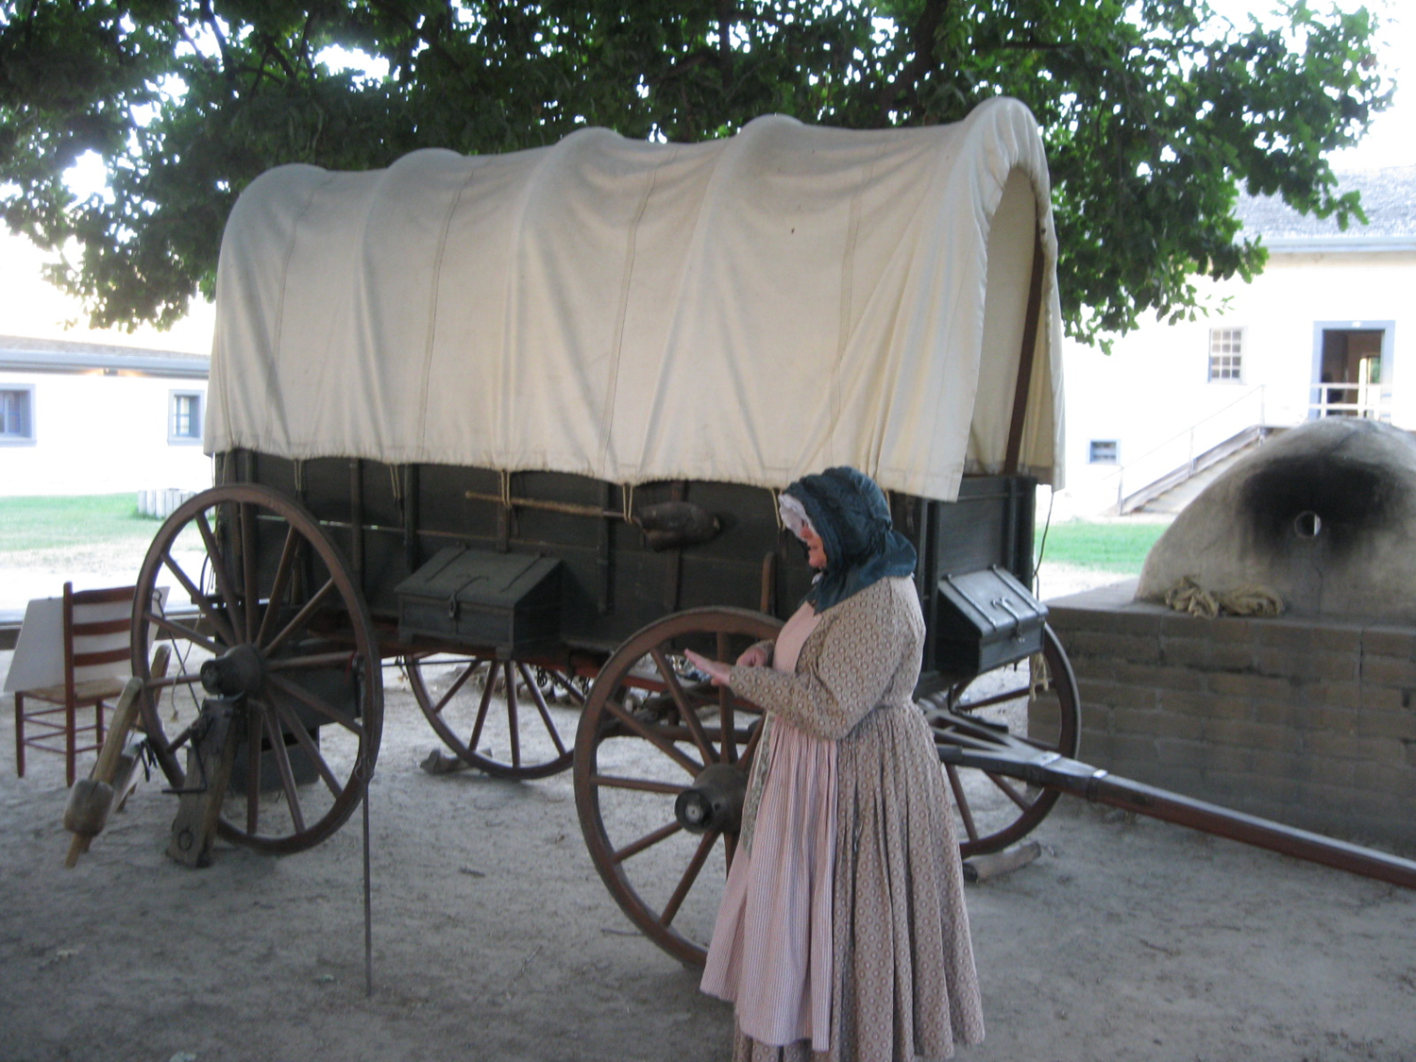
The Oregon Trail led thousands of farmers to the fertile lands of Oregon in the 1840s
2,000 miles
Covered Wagons
1 to 2 miles per hour
About 100 miles/ week
5 month journey
“Oregon Fever”

Slide 11
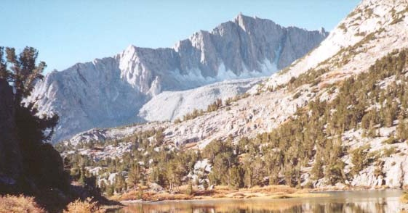
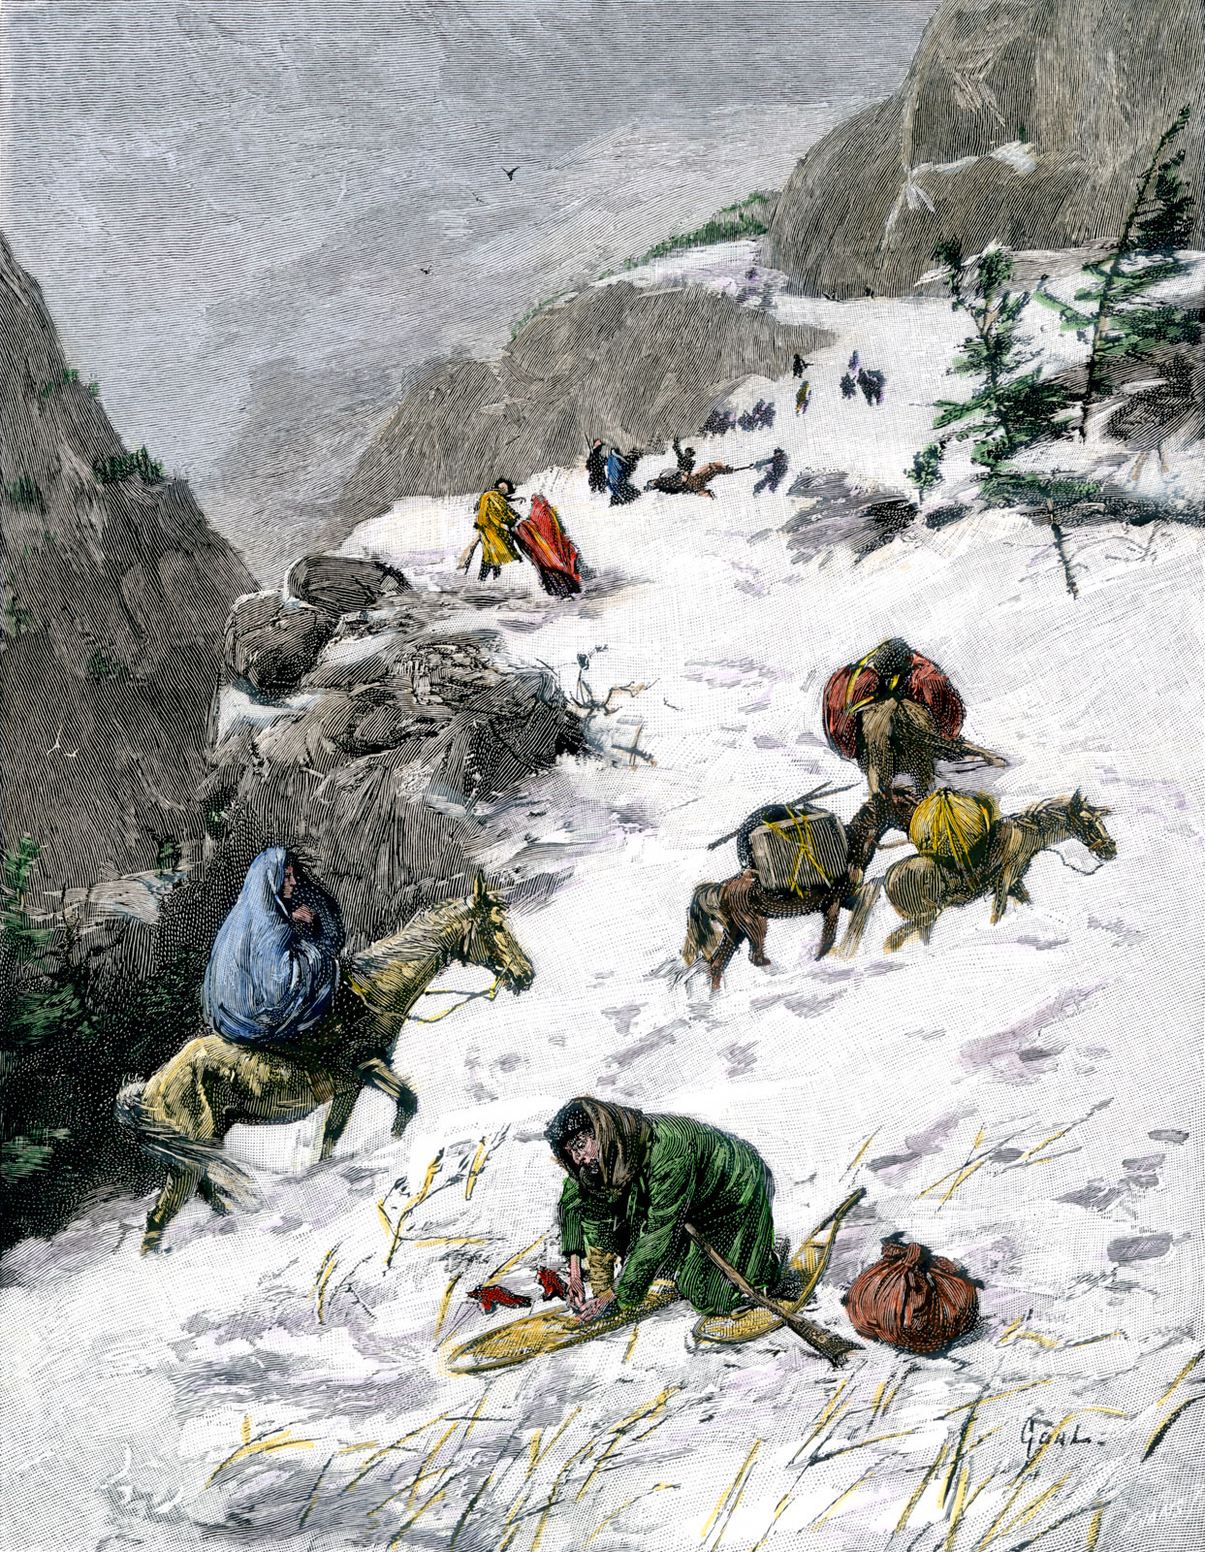
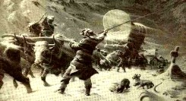
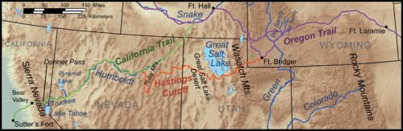
Donner Party
Group of California bound American settlers
Become snowbound in the Sierra Nevada in the winter of 1846–1847
Some of the emigrants resorted to cannibalism
Of the original 87 pioneers, 39 died

